Slide 1
User Interface

Slide 2
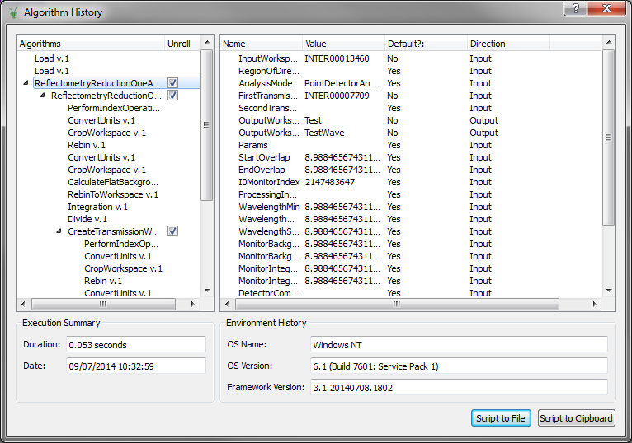
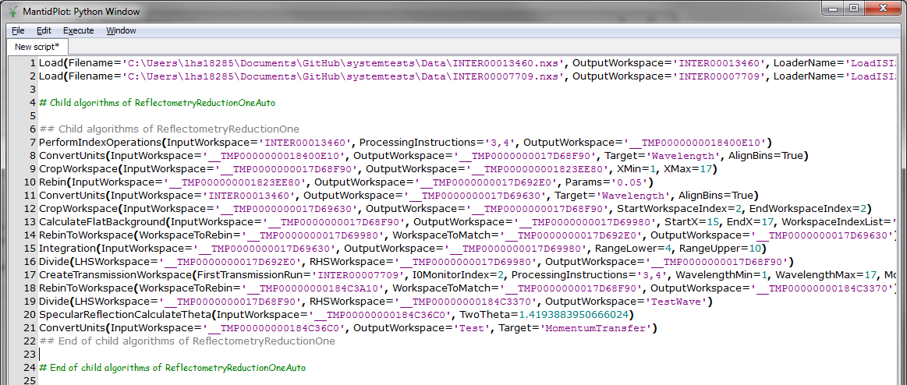
Nested Algorithm History
No more black boxes
Records algorithms run and parameters used
Distinction:
Algorithms vs. Work-flow algorithms
Script generation from history
To any level of depth
History available through the Python API

Slide 3
Indirect Inelastic

Slide 4
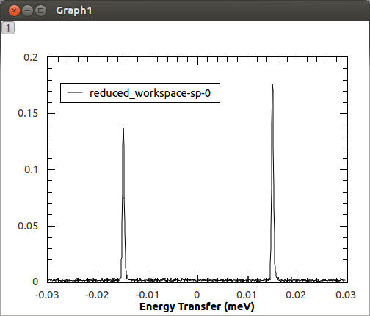
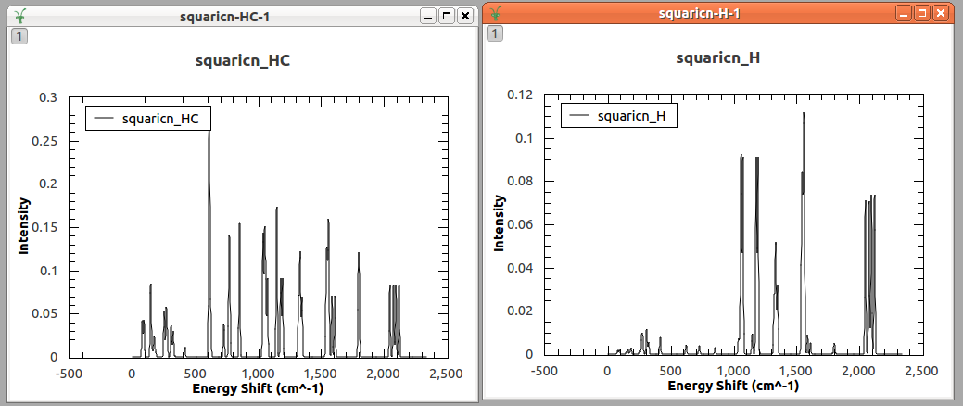
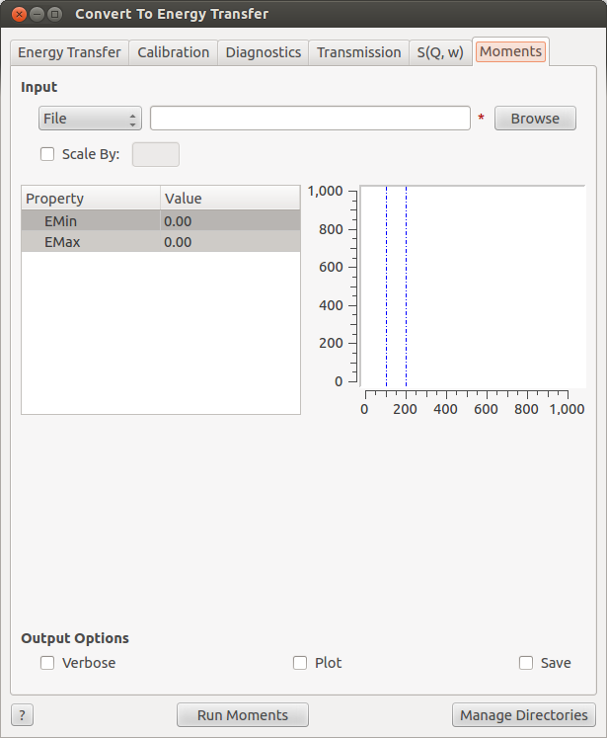
Indirect Inelastic
New algorithm: IndirectILLReduction
For IN16B
DensityOfStates
Partial contributions both summed and individual.
Calculate Corrections
Uses chemical formula for cross-sections
New Moments tab
Calculates moments of an S(Q,w)
Just another algorithm: SofQWMoments
ConvFit
Temperature correction

